Slide 1

Numpy advanced library in python
By,
Disha s. shah

Slide 2
index
Advanced libraries in python:-
What is NumPy library in python?
Why NumPy library is used?
Features of NumPy library:-
Advantages & Disadvantages of NumPy library:-
Use cases in real world of NumPy:-
Examples of NumPy library:-
Mini project overview:-
Project code snippets and output:-
GitHub mini project link and resources:-
Conclusion

Slide 3
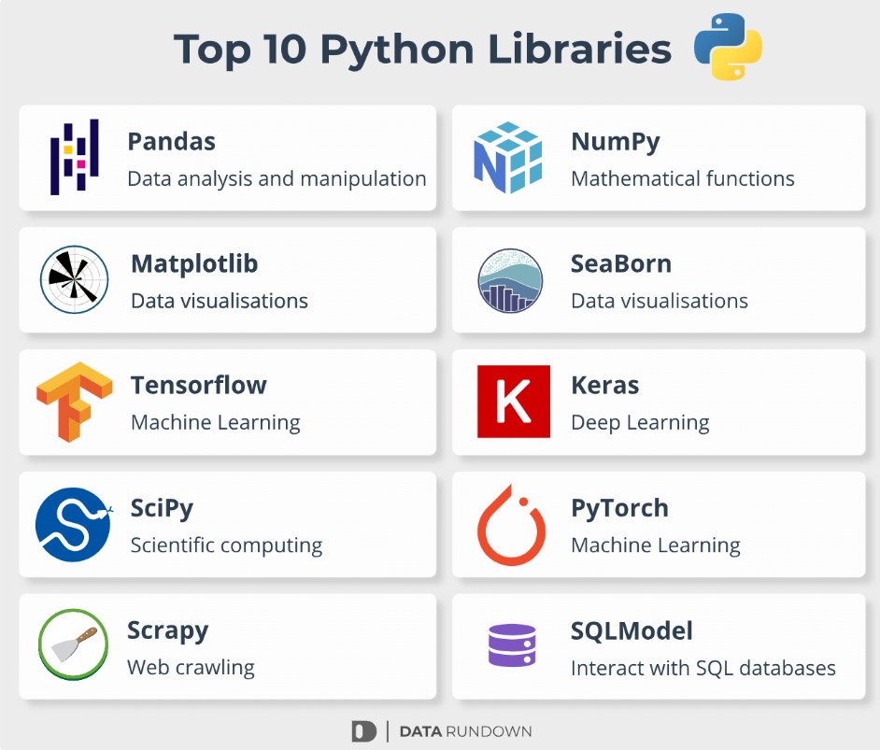
ADVANCED LIBRARIES IN PYTHON

Slide 4
WHAT IS Numpy library in python?
NumPy (Numerical Python) is the essential package for numerical computation in Python.
NumPy gives you fast, precompiled functions for numerical routines.
It has an array-processing package that gives arrays and tools for working with them.
NumPy is extensively used in data analysis.
NumPy is a good start for your first library to explore after getting the basic fundamentals in the Python environment.

Slide 5
Why NumPy library is used?
NumPy is used for
Open-source library for working efficiently with arrays
Makes complex mathematical implementations simpler
Used together with other libraries like Matplotlib, NumPy can be viewed as an alternative to MATLAB’s core functions

Slide 6
Features of NumPy library
Interactive and easy to use
Speed for mathematical calculations
Significantly improves the ease
performance of working with multidimensional arrays

Slide 7
numpy
ADVANTAGES
DISADVANTAGES
Efficient Array Operations
Multi-Dimensional Arrays
Mathematical Functions
Interoperability
Community Support
Cross platform
Learning Curve
Memory Consumption
Limited Data Types
Compatibility Issues
Not Suitable for All Tasks
Performance Trade-offs

Slide 8
Use cases in real world
Data analysis and processing
ML & AI
Image processing
Scientific computing
Game development
Financial modelling
Robotics & IoT

Slide 9
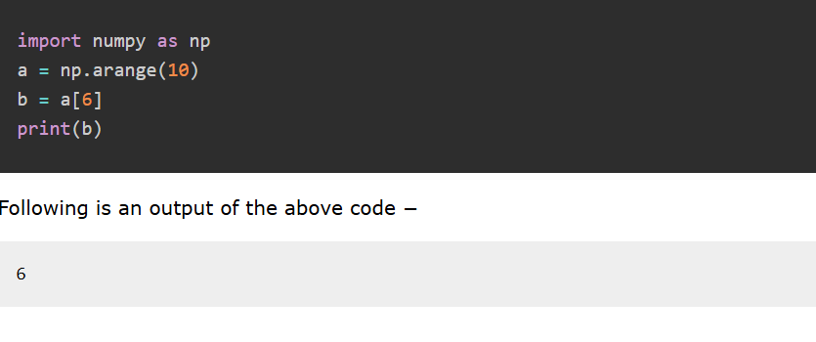
EXAMPLE OF NUMPY USING INDEXING:-

Slide 10
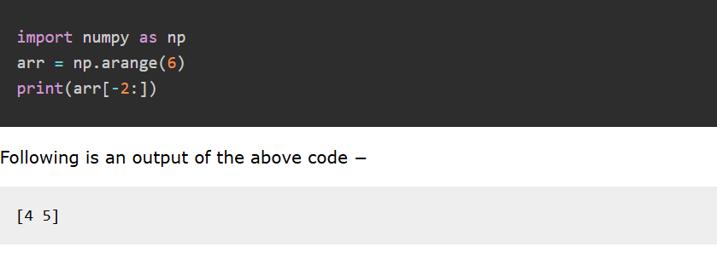
EXAMPLE OF NUMPY USING SLICING:-

Slide 11
MINI PROJECT OVERVIEW
TITLE :- Random Number Statistics Using NumPy
OBJECTIVE :- Generate random numbers and compute their statistical values.
LIBRARY USED :- NumPy
INPUT :- 50 random integers between 10 and 100
OUTPUT :- Mean, Median, Standard Deviation, Max, Min

Slide 12
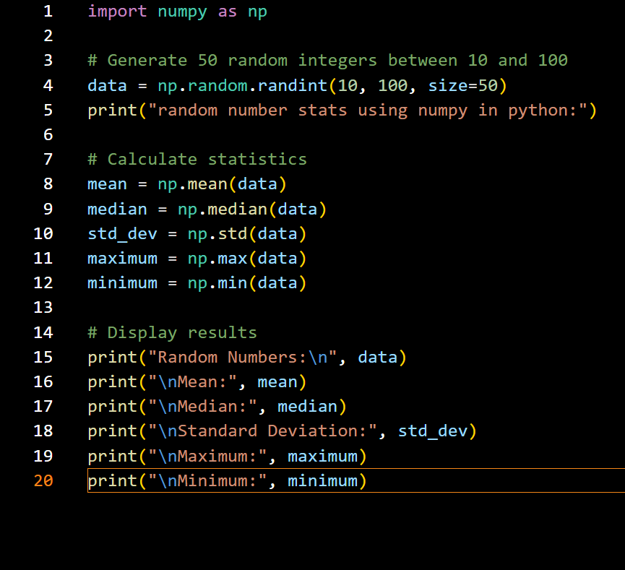
Project code:-

Slide 13
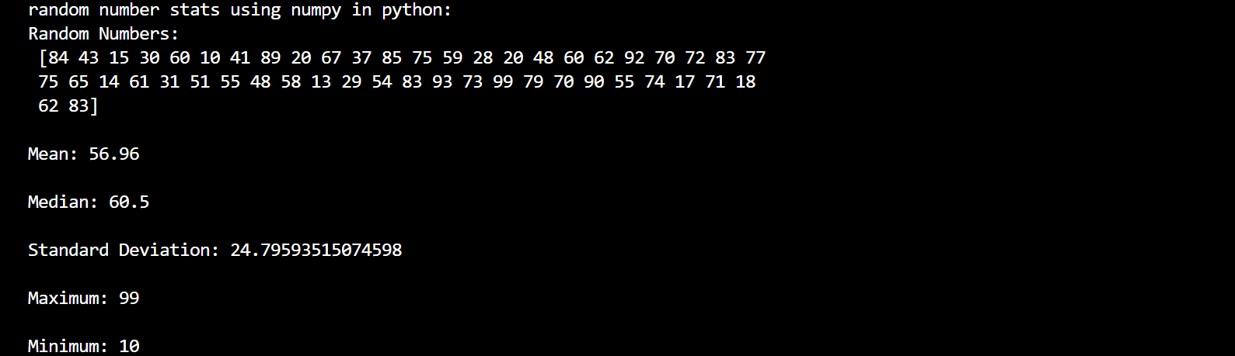
Project output:-

Slide 14
GITHUB PYTHON MINI PROJECT REPOSITORY LINK :-
GitHub Repo
https://github.com/DISHAGIT-HUB/python-mini-project-numpy.git
RESOURCES :-
Learn NumPy
NumPy Documentation and Getting Started
Cheat Sheet: NumPy Basics by Datacamp
Conclusion :-
“this project helped me to understand how NumPy handles the random data and statistical operations efficiently.”

Slide 15

Thank You!
Name:- disha santoshkumar shah
Enrollment no.:- 2302030430147
Roll no.:- 68
batch:-b.tech[4ce-a/a2]
Directed by,
Prof.monika chauhan

